Slide 1


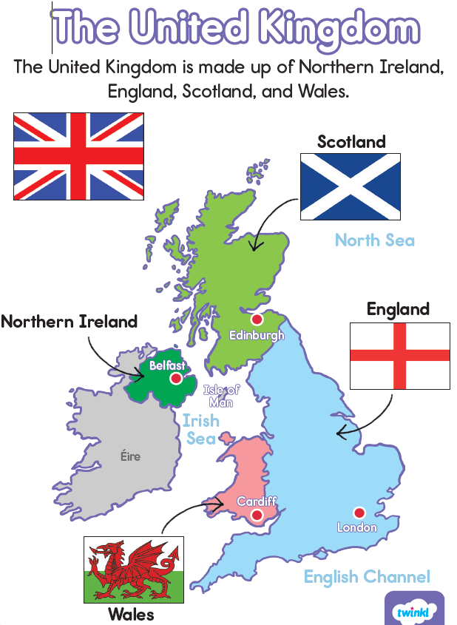
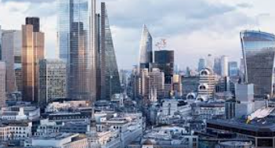
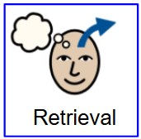
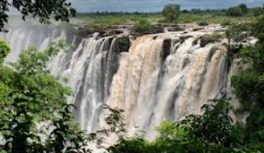
Where do people live? - Year 2 - Term 1
Capital Cities
The capital of a country is a city or town where the main government leaders work. Capitals are usually large cities. Here are the capital cities in the UK:
London
Edinburgh
Belfast
Cardiff
The United Kingdom
The United Kingdom is made up of 4 countries:
England
Scotland
Wales
Northern Ireland
Settlement
A place where no one has lived before that people choose to make a community.
What do you already know?
What is a town?
What is a city?
Can you name the four countries of the UK?
What human and physical features do you know in your town?

Slide 2

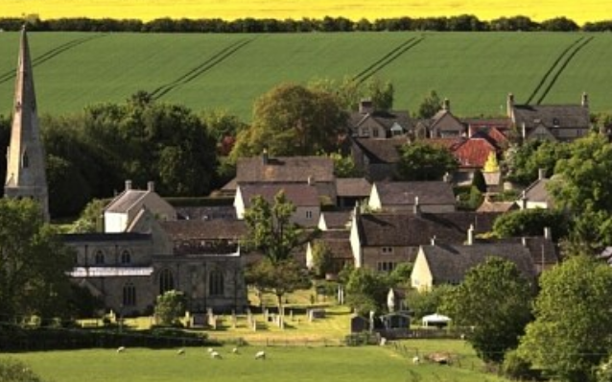
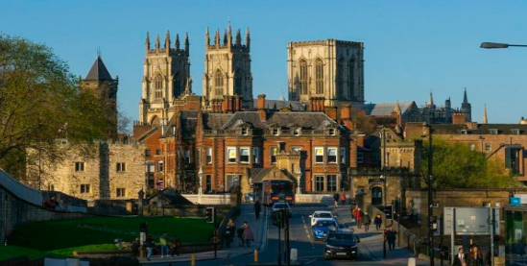
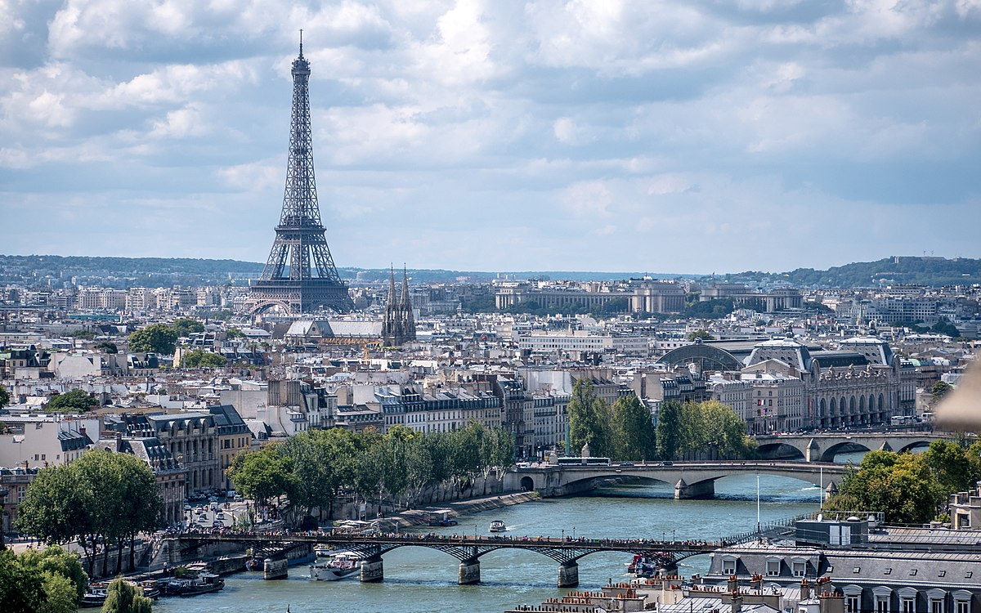
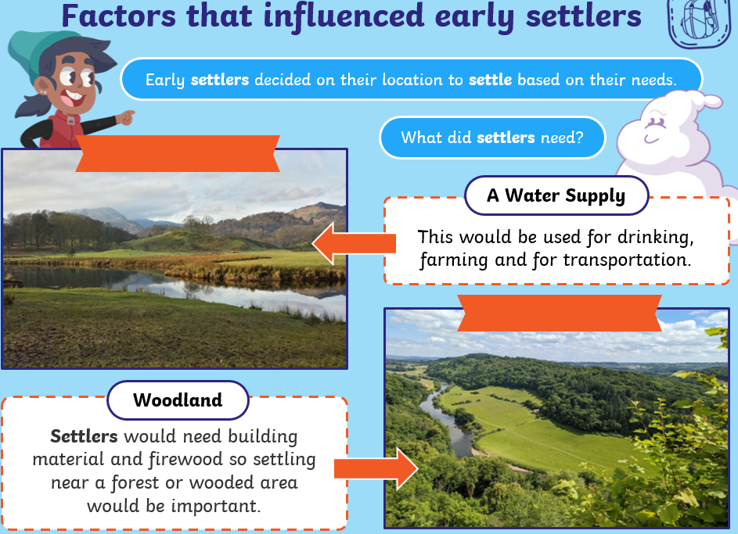
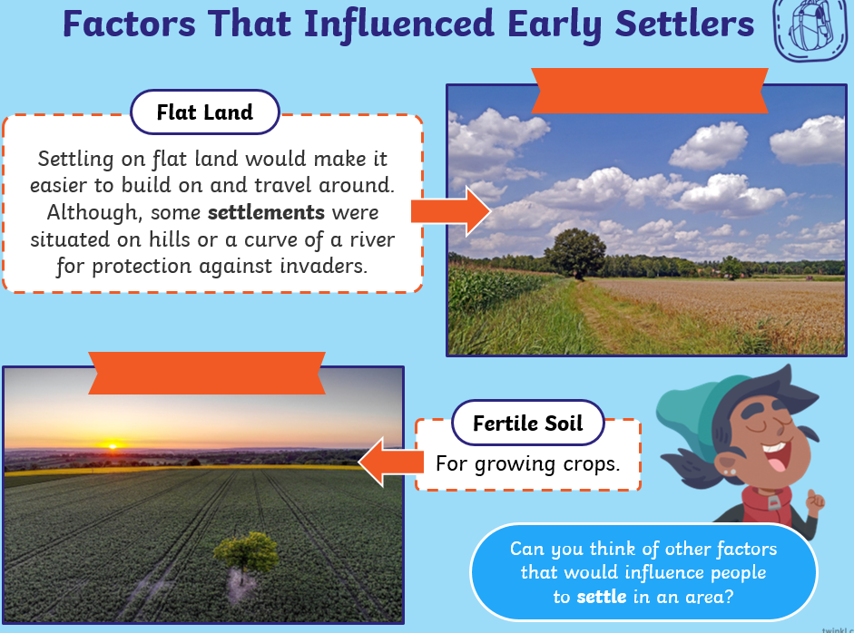
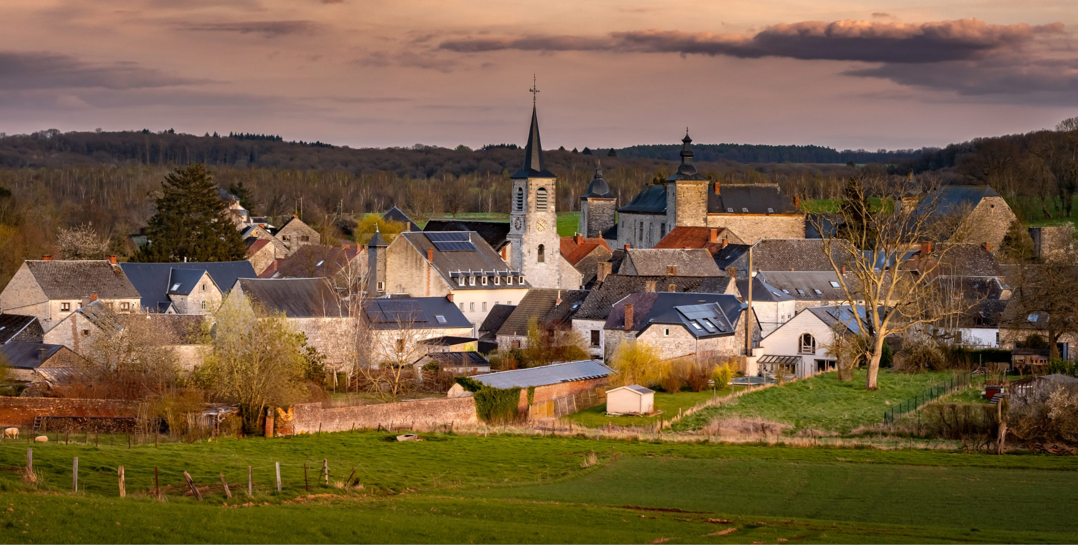
Vocabulary
Capital City | A city where the region’s government is located.
City | A city is bigger and a busier area. People live in small apartments buildings and very few people live in houses. It has very high traffic and you will hardly see any farms around. The population of a city is higher than a town.
Community | A group of people with the same things in common.
Human Geography | This focuses on where people live, what they do and how they use the land.
Local | Existing or belonging to an area that you live.
Locality | A place and its surroundings.
Physical Geography | Study of the Earth’s natural features.
Town | A built-up area where people live. It is larger than a village and generally smaller than a city.
Village | A community made up of a small number of houses that is often found in a rural area.
Type of settlement
Village
Town
City

